Slide 1
Salmon Economics
Ken Walton

Slide 2
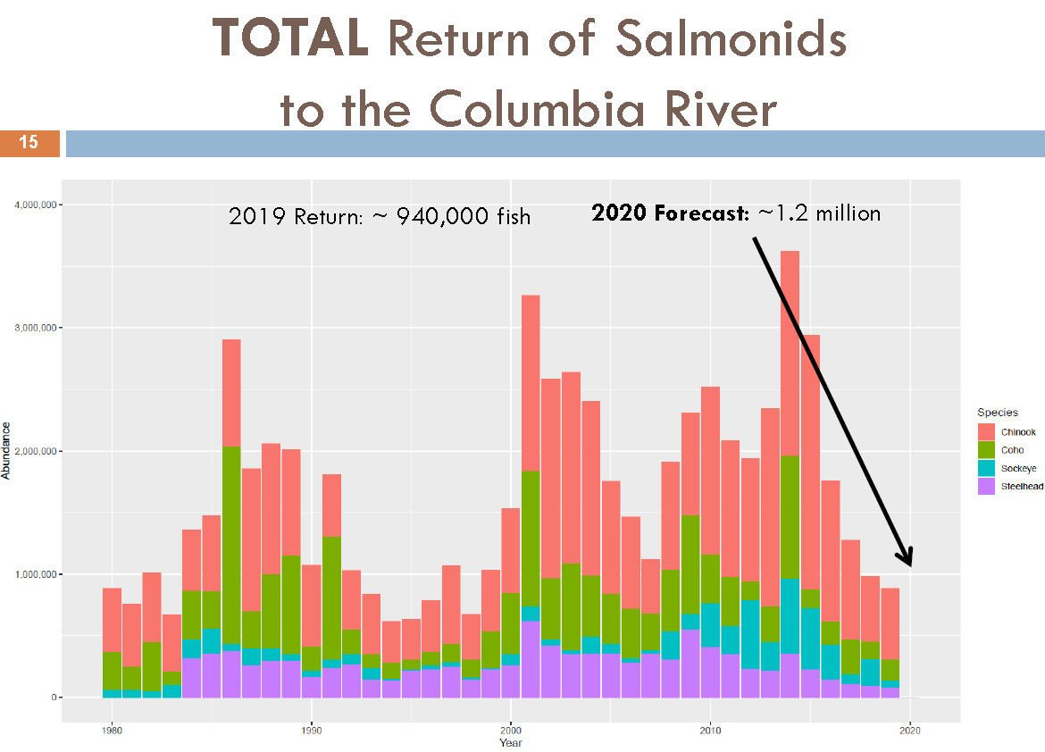
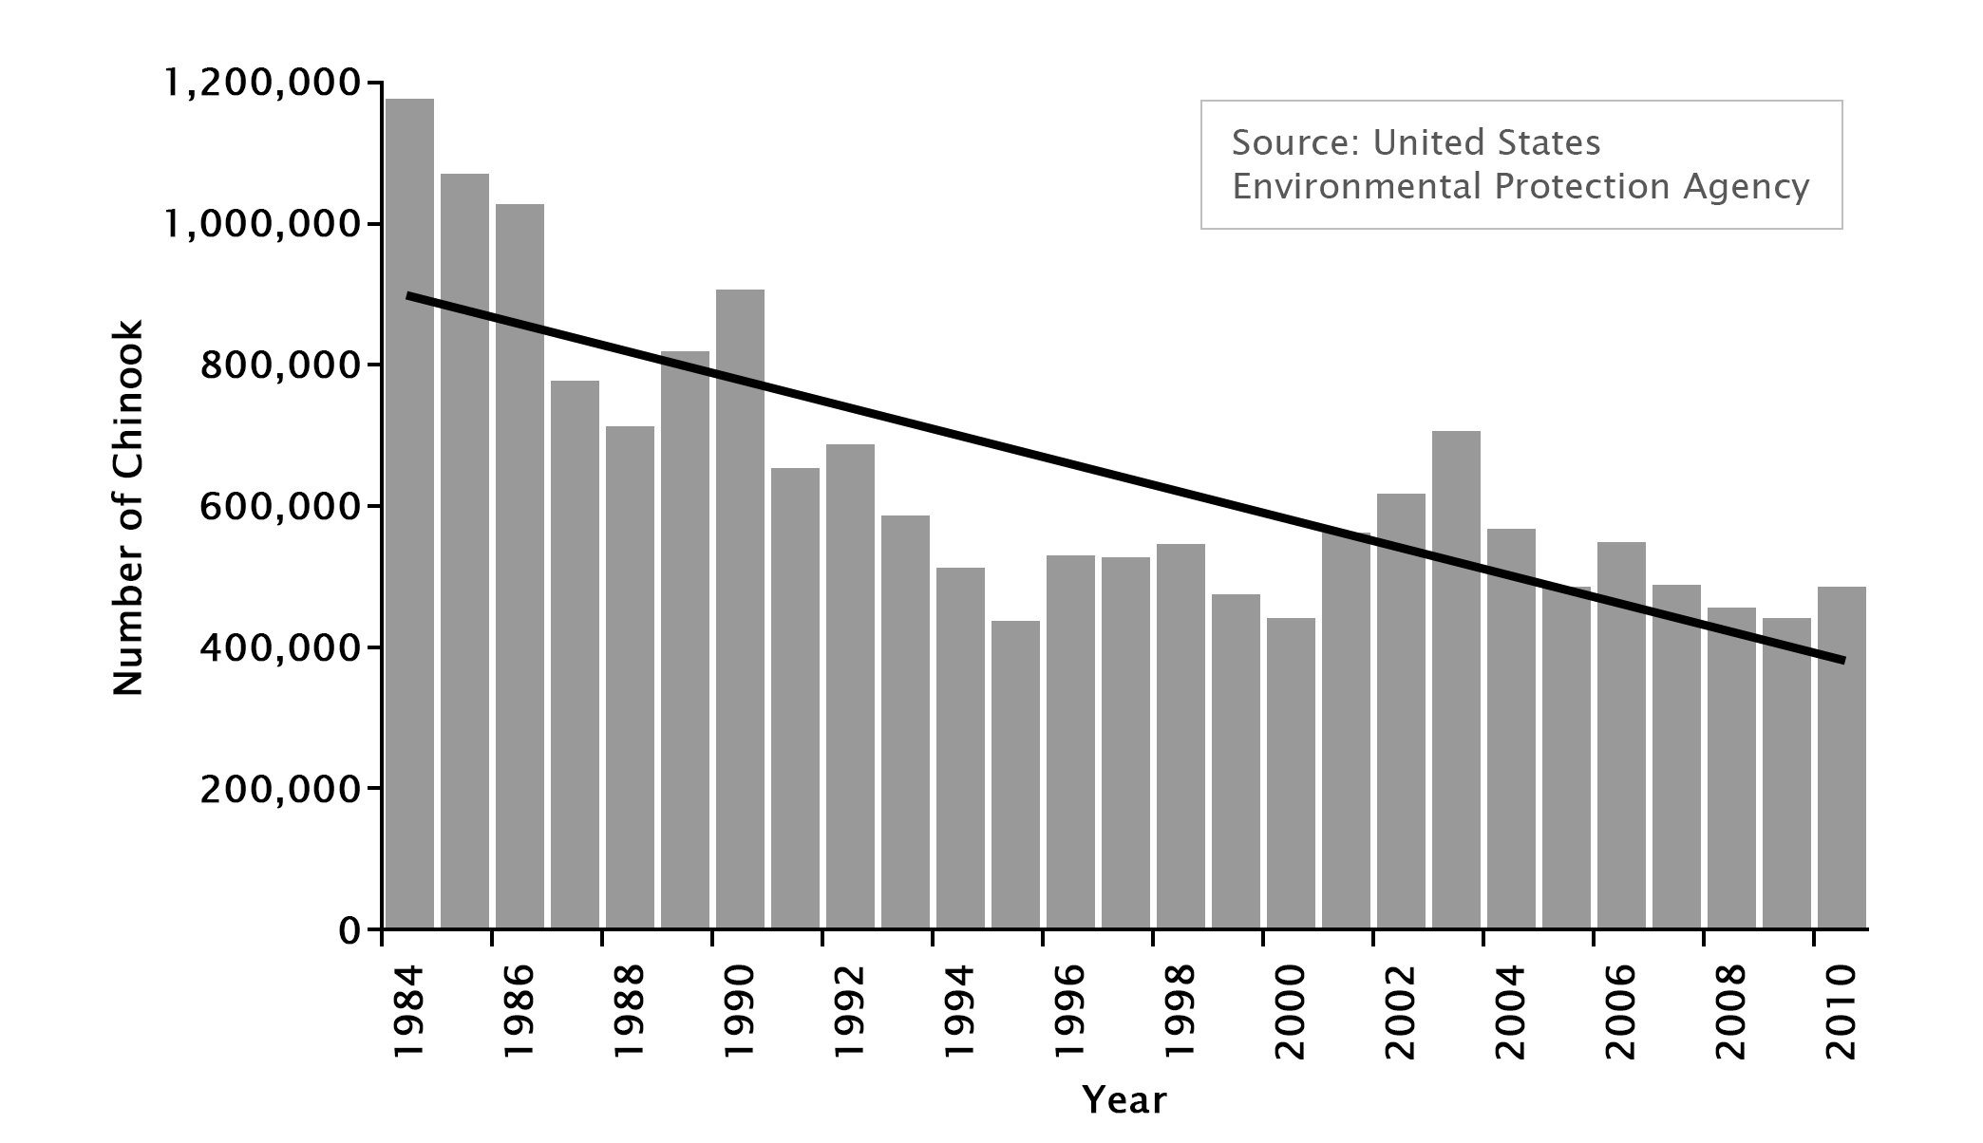
Introduction
Northwestern United States area has had declining salmon populations
Columbia River Basin
Dams
Pollution
Glaciers

Slide 3
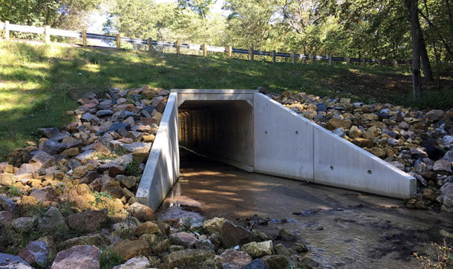
Literature Review
Population Decline
Culverts
Removing Dams vs Adjusting
Value of Fisheries

Slide 4
Methodology
Travel analysis
Count People and Zip Code
Demographic
Direct travel cost
Indirect Costs
Equipment costs
Regression
Demand curve
Cost Benefit Analysis
Costs – Labor, Material, Land, Licenses, Environmental Damage
Benefit – Electricity
Cost > Benefit ?
Find social optimum

